Slide 1

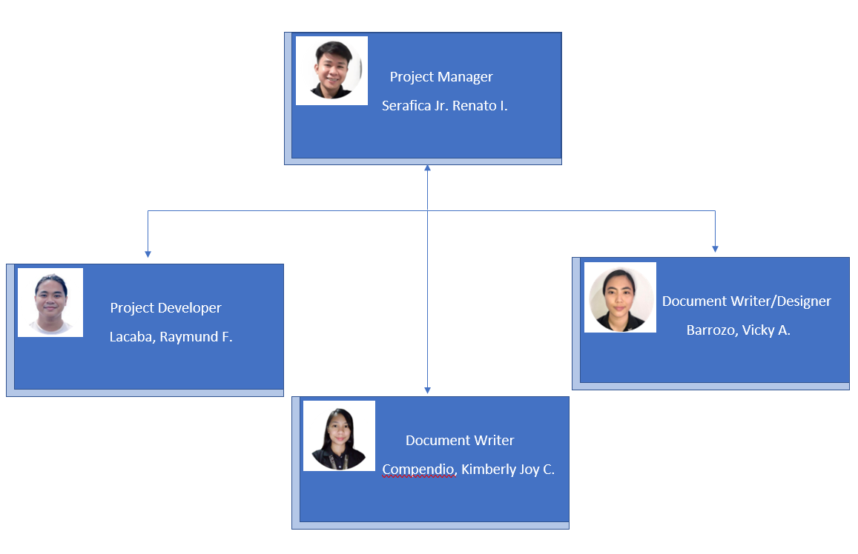
The Team

Slide 2


Slide 3

Street Tech
ITE 351 New Venture - Block 6

Slide 4
Project Venture Description
Street Tech is an online-based business where customers can browse and buy in a wide range of smartphones, and accessories like cases, power banks, and airpods.

Slide 5
PROBLEM
Competitor
Start-up cost
Limited experience in sales strategies
Customer satisfaction

Slide 6
SOLUTION
Utilize the use of social media platforms and create captivating posts, banners and include the website’s link where customers can directly transact.
Minimize overhead expenses.
Focus on creating the need and how customers will benefit from the product. Highlight the features and specifications of the products.
Always asks for feedback in every transaction. Provide proactive support. Respond quickly.

Slide 7
FORM OF BUSINESS
Street Tech falls under General Partnership. By definition, general partnership refers to “a form of business organization in which two or more people pool their skills, abilities, and resources to run a business.” As a business that is only starting out, we think it best for the business’ survival and success to not only rely on a single person. This also means that the skills and abilities of more than one individual are available to be utilized by the business.
Street Tech handles the payment and shipping process as well as reclamation.

Slide 8
POINT OF BUSINESS
Our business can get revenue from sold products. In addition, we can get revenues from related companies or individuals who wants to put an ads in our website’s mini blog.

Slide 9
SCOPE AND LIMITATION
The application includes sign up and login page, blog, home features, shopping cart, check out page, feedback page, and navigator.
The application includes couriers like J&T, LBC, and store own delivery.
The website includes payment methods through debit cards.
The business will not only operate within pangasinan area.
The website is not only limited smartphones, but also we can include accessories on our website like cases, and power banks.

Slide 10
Target Customers
Teenagers
Adults

Slide 11
STAKEHOLDERS AND ENTITIES INVOLVED
Web Developers
Registered Couriers
Bureau of Internal Revenue
DTI Registration Certificate

Slide 12
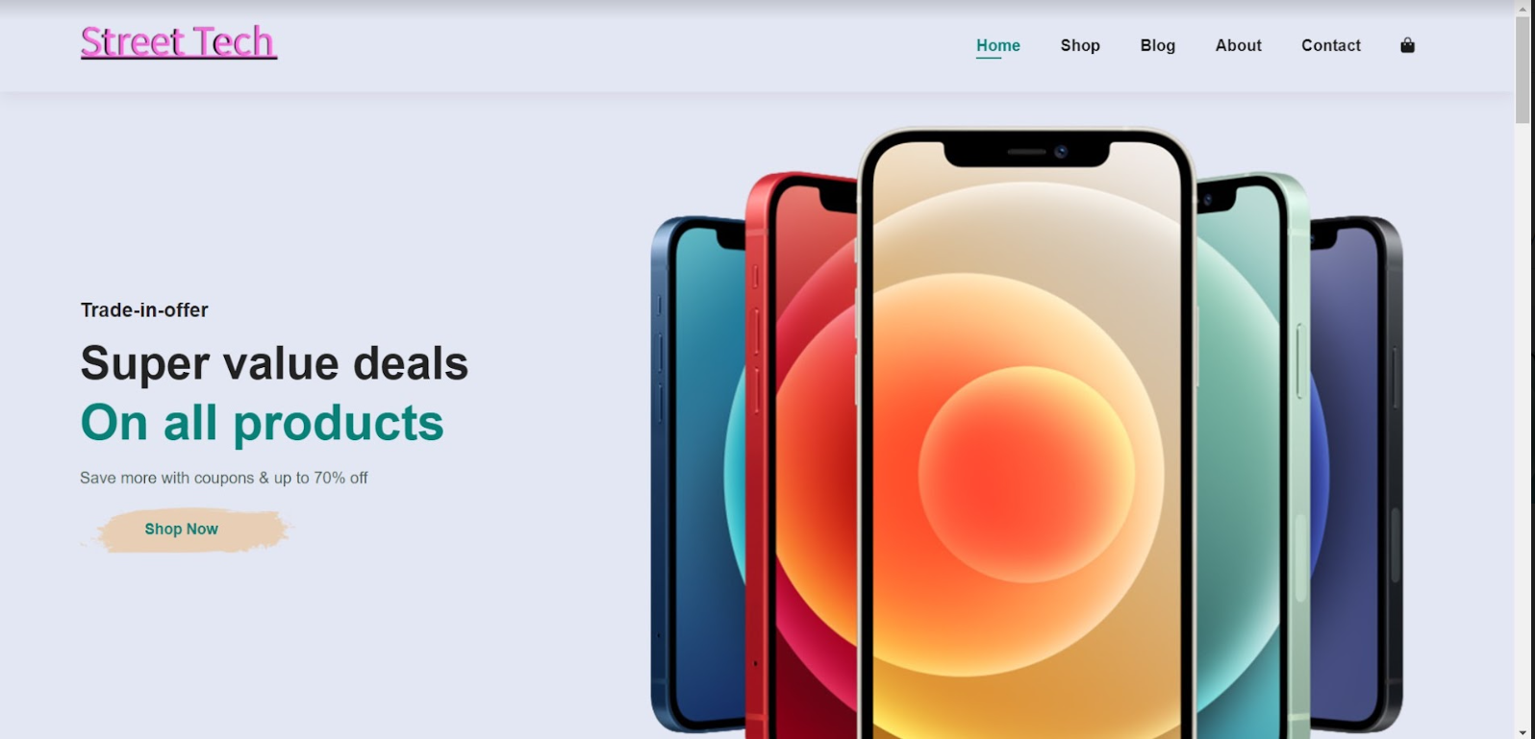
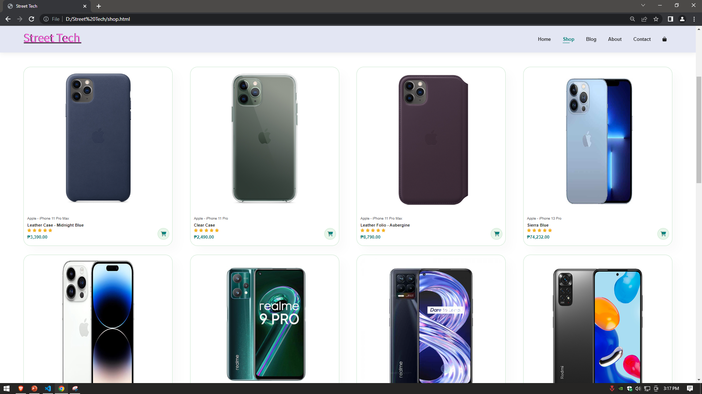
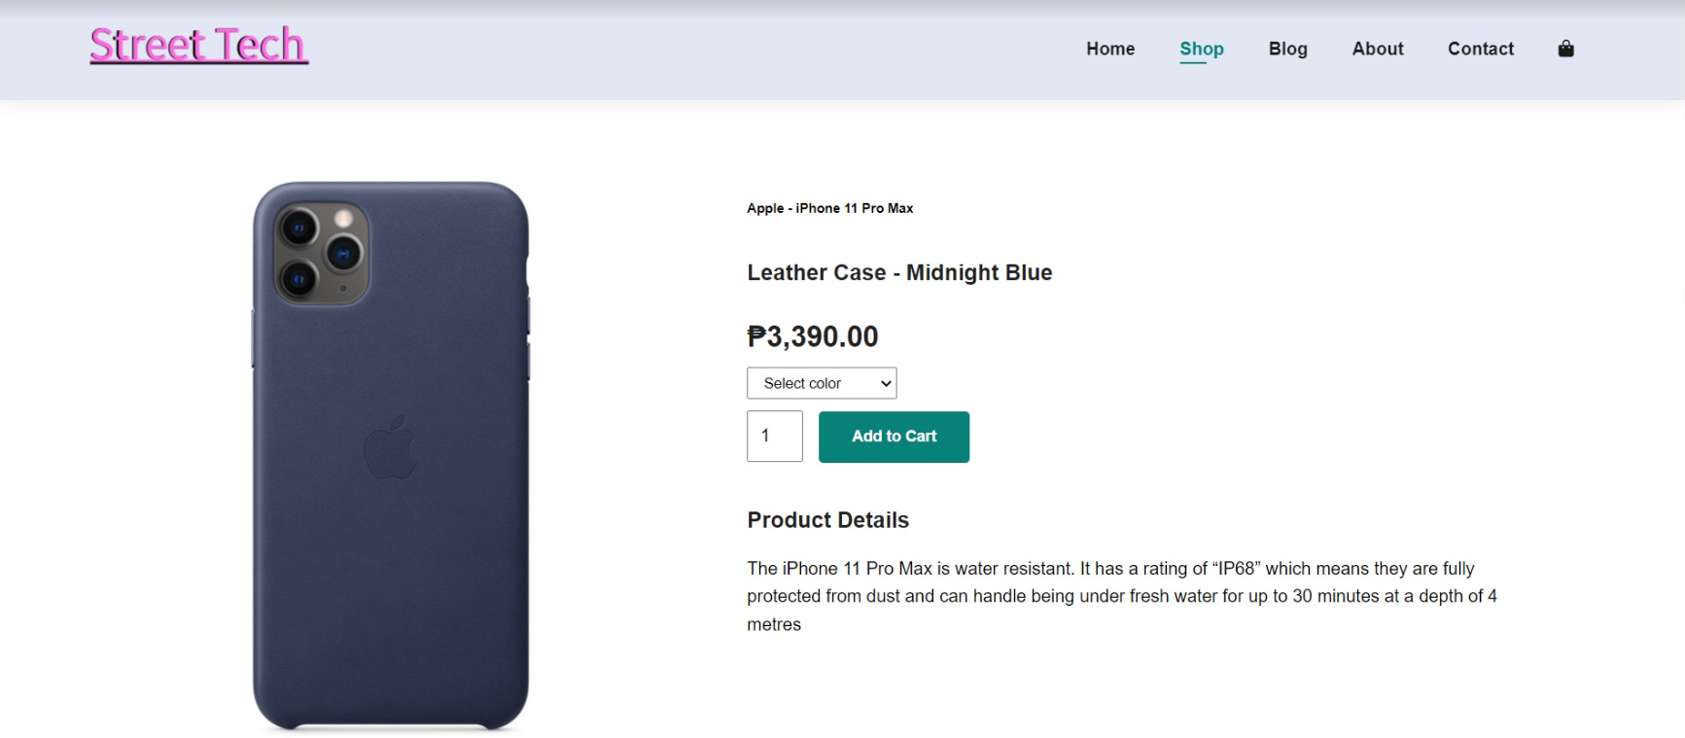
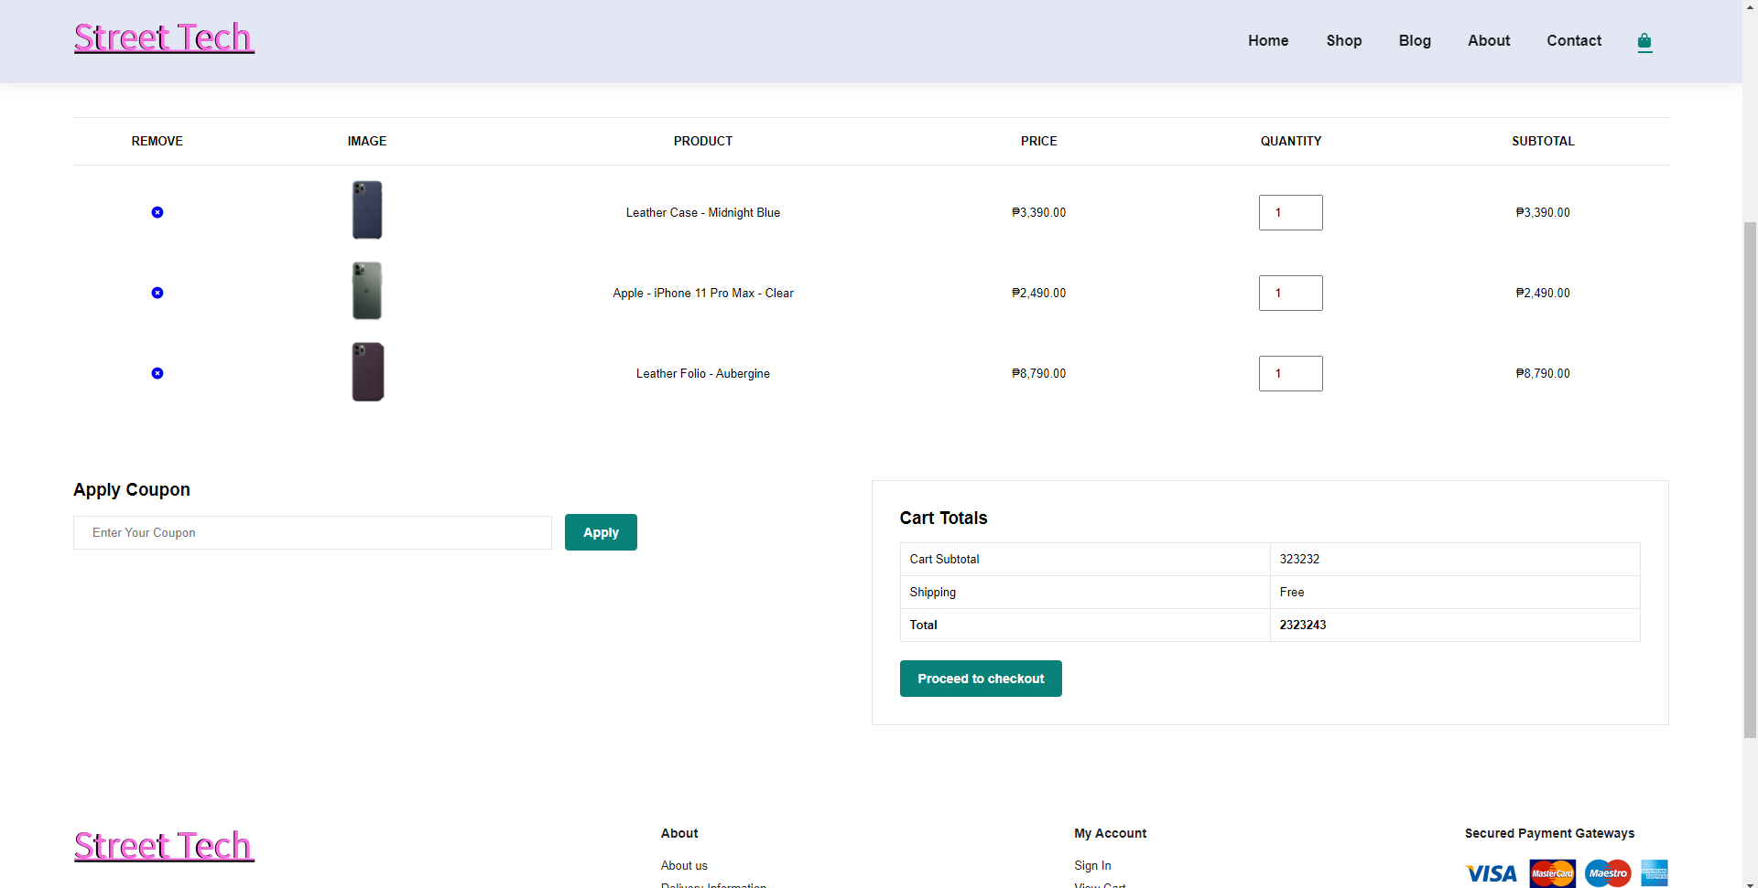
Web Development

Slide 13
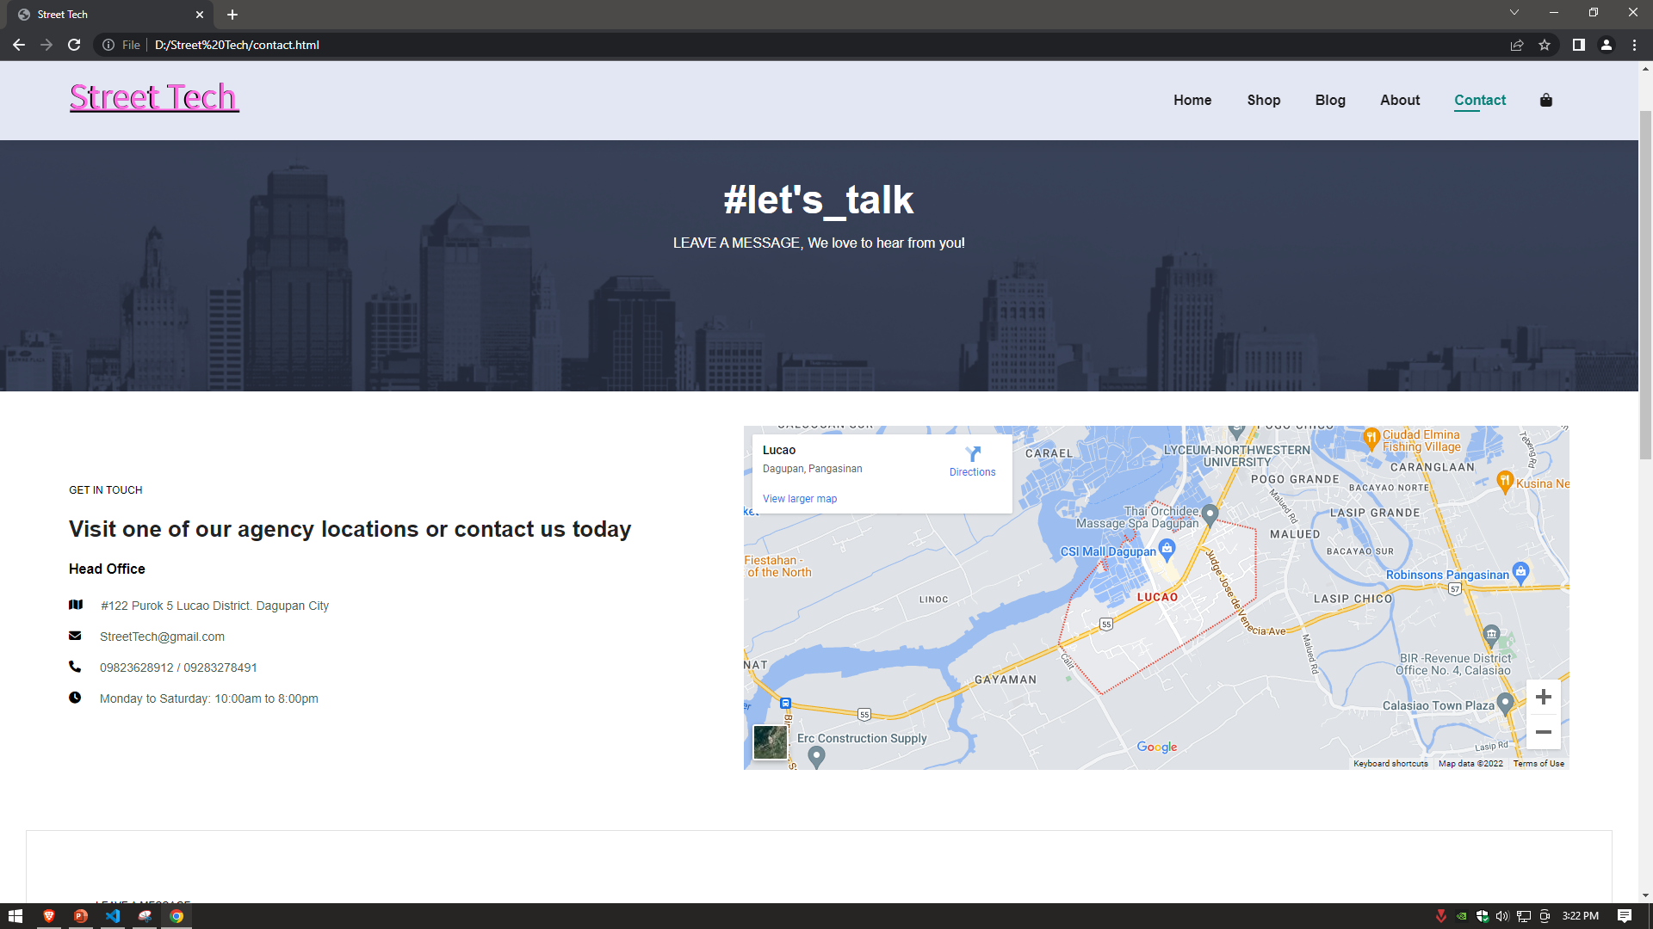
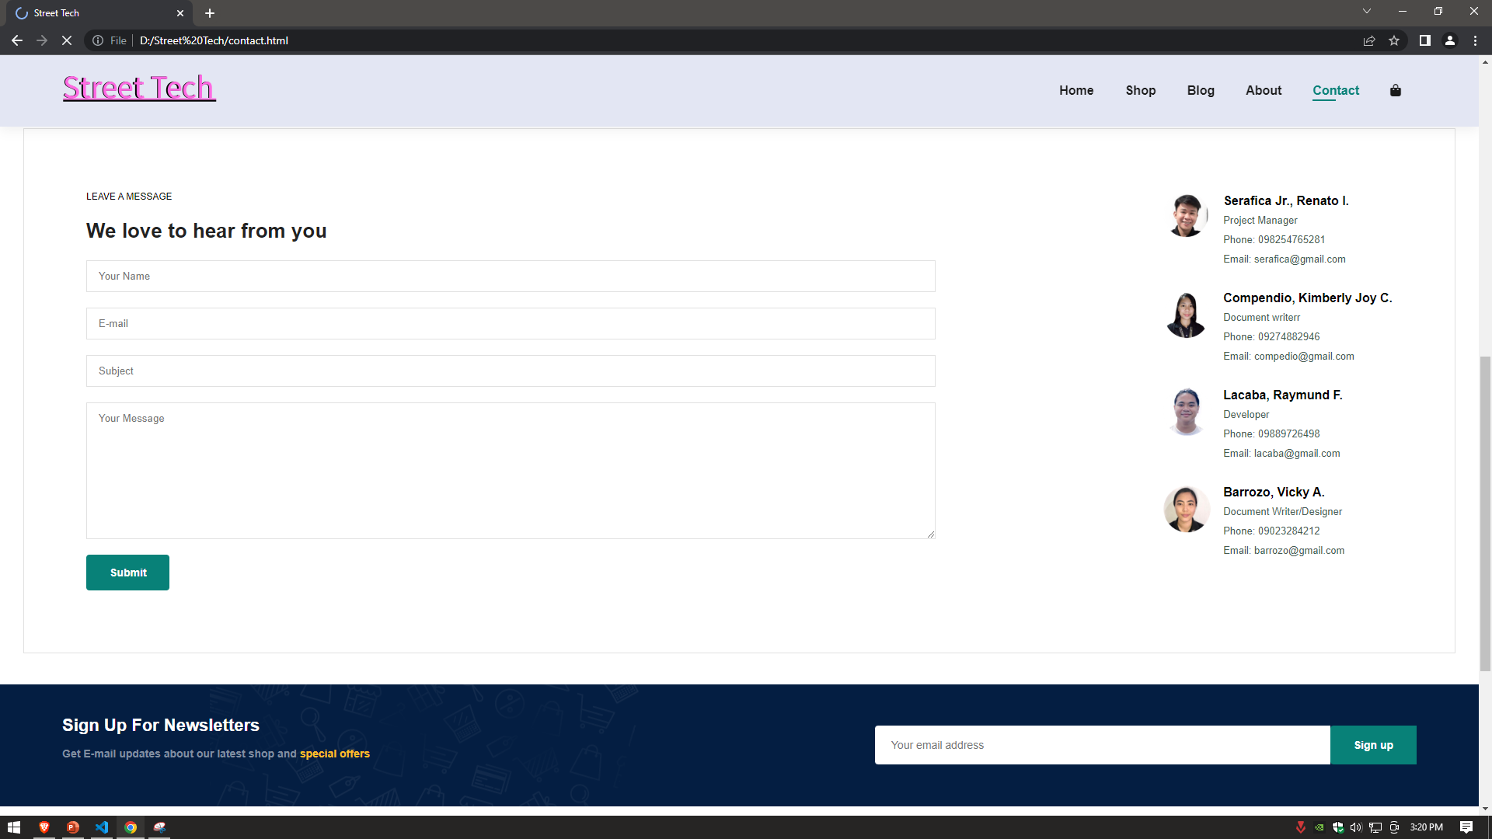
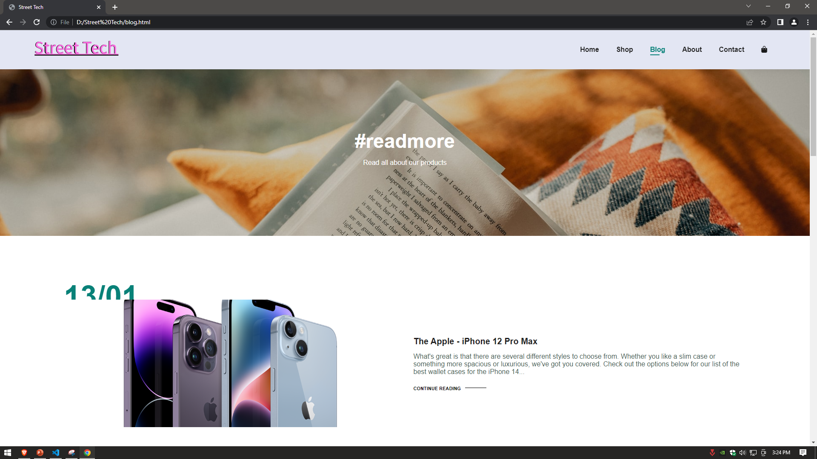
Web Development

Slide 14


